Slide 1


“The futures of agriculture, food and rural development:
Drivers and scenarios
3rd Workshop on Drivers and Trends of the Future Developments of Non-Communicable Diseases
October 26th 2015, Lisbon, Portugal by Dr. Ir. Robin Bourgeois,
Senior Foresight Advisor, GFAR Secretariat , Rome
Senior Scientist, CIRAD, France
S

Slide 2

CONTENT
Drivers, trends and disruptions
  Globalization
  Connectivity
  Consumption patterns
  Resources
  Population dynamics
  Urbanization
  Technology development
  Prosperity

Slide 3
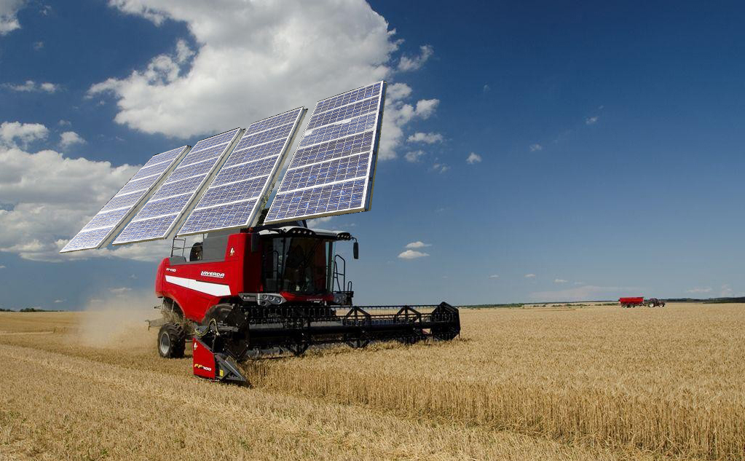
CONTENT
Seven plausible scenarios
  Rural stations
  Rural ghettos
  Rural niches
  Rural poles
  Farming cities
  (peri)- Urban farming
  Rural Continuums

Slide 4
DRIVERS, TRENDS AND DISRUPTIONS
Drivers, trends and disruptions
  Globalization
  Connectivity
  Consumption patterns
  Resources
  Population dynamics
  Urbanization
  Technology development
  Prosperity

Slide 5

Globalization and localization
Cross border flows of money, goods, ideas and people, but also pandemia. Better protection against local hazards but also more sensitive.
More local and regional conflicts and interests competing for resources.
When remoteness combines with low investment, rural areas fall into the margins of globalization.
A new nexus based on local complementarities between former rural areas and former urban areas can emerge.

Slide 6

Connectivity
Connection is cheaper and easier all-time, everywhere, for all.
Connectivity divide in quality and intensity according to the wealth of the connected users
Rural areas and agriculture benefit or suffer from the digital connectivity through either an increasingly connected system or a growing digital divide

Slide 7
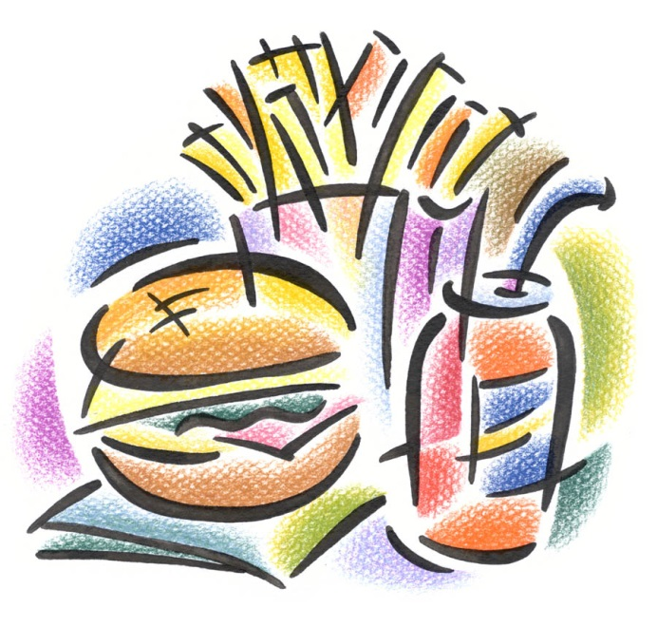

Consumption patterns
We live beyond the means of the planet and will further do.
Threat on consumption trigger changes towards more sustainable consumption patterns.
Mass consumption of standardized cheap product empties the countryside
A diversified demand may sustain the development of rural areas.

Slide 8
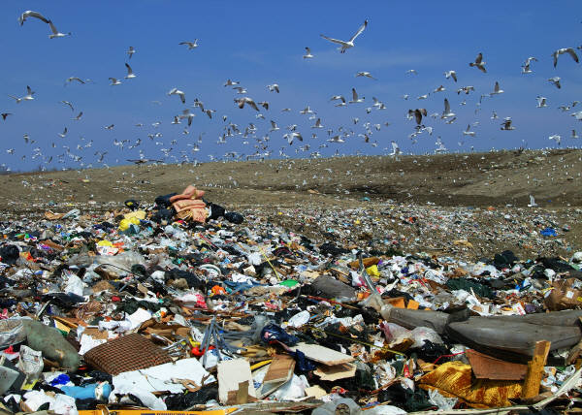
Resources
Declining biodiversity, quality of water and soils, cost and access to energy, and stronger more frequent climatic hazards.
More environment conscious behaviors support initiatives for a more sustainable use of resources.
Poor rural populations depending on natural resources most affected.
Urban poor increasingly affected.
Massive reverse migration to rural areas.

Slide 9
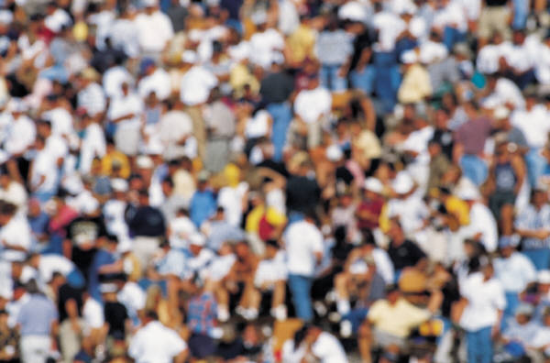

Population Dynamics
More people on earth. Older people will live in developed countries. Countries with cohort of young population are less able to support them leading to cross country migrations.
Density and population pressure in rural areas are widely diverse influencing employment opportunities in farming and non-farm sectors.

Slide 10
Urbanization
Cities offer employment, entertainment, services and social life.
Mega cities expand, medium cities grow, unclear boundaries between urban and rural.
Re-ruralisation, people prefer the countryside.
Conversion of agricultural land
Further migrations to cities
Re-vitalisation of rural areas by new inhabitants.

Slide 11

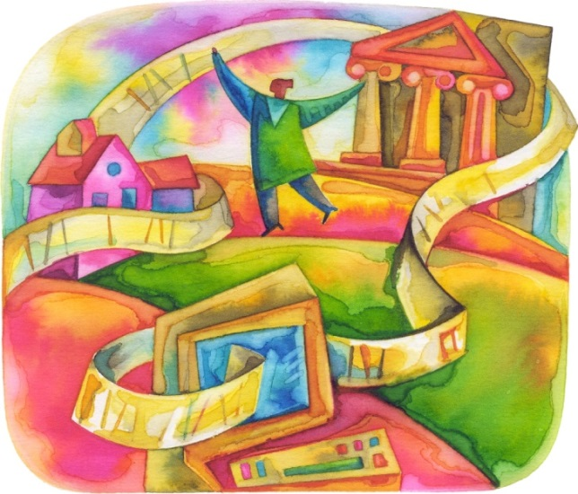
Technology development
Producing more with less. Climate change drives technological change. Technologies focus on productivity, a few crops and products.
Resilience responds to climate change and proposes alternative technologies.
Local adaptation of technologies determine the viability of farms
Disparate situations depending on resources, infrastructure, investment capacity, access to knowledge.

Slide 12

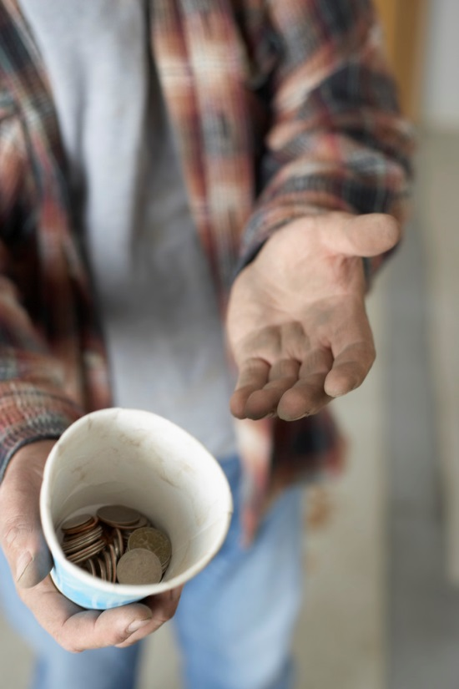
Prosperity
Poverty declines, inequalities rise.
Disparities between urban and rural areas. Few winners, many losers.
Urban poverty prevails over rural poverty leading to further policies for cities and discriminating rural areas.

Slide 13
SCENARIOS
Seven plausible scenarios
  Rural stations
  Rural ghettos
  Rural niches
  Rural poles
  Farming cities
  (peri)- Urban farming
  Rural Continuums

Slide 14
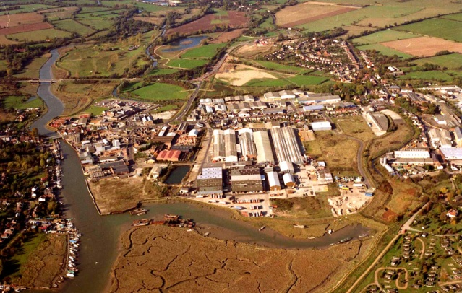
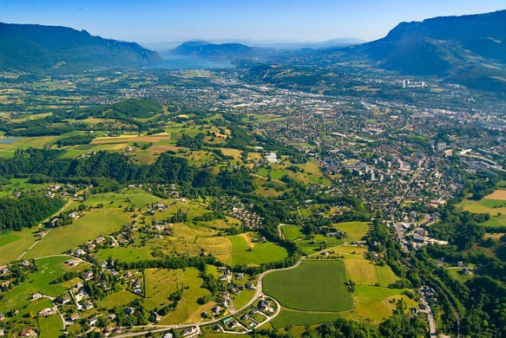
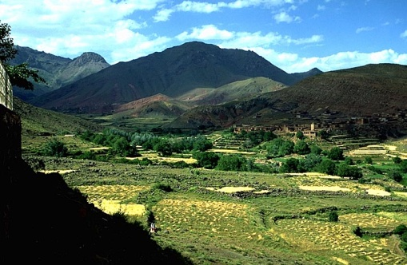
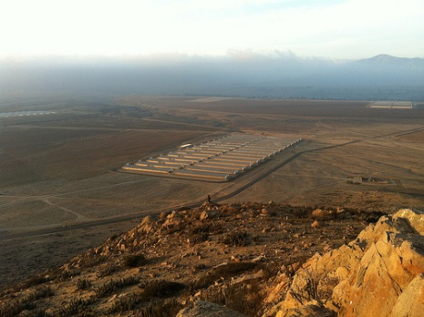
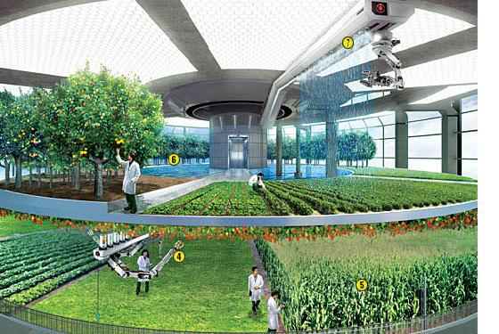
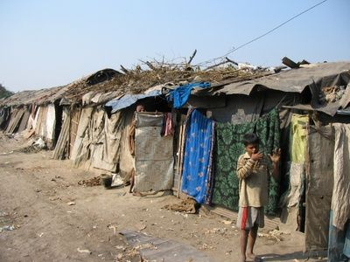
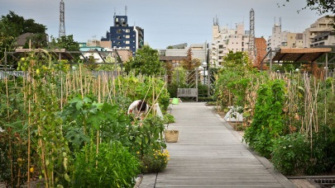
Scenarios at the crossroads of
consumption and production and development policies
Food production and transformation, but also many non-farm activities, take place in small diversified enterprises and operate in an environment providing connectivity and employment opportunities. “Farmers” will have several jobs and will be directly connected to markets and consumers through appropriate ICTs. Quality of life will not be significantly lower than in urban areas. Potentially everywhere.
High-tech agriculture takes place in the highly controlled environment of city agri-buildings providing a diversity of products. Farmers are graduated technicians, employed by municipalities or city-farm companies. Densely populated areas in Western Europe, Scandinavia, and as part of all mega-cities everywhere (Tokyo, Hong Kong, Mexico, Jakarta, etc.).
Revitalisation of rural areas
Gigantic agro-industries employ a limited number of workers living in an agro-industrial complex. Work is robotized, unless poverty makes human labour cheaper. The complexes are highly specialized, isolated but hyper-connected to markets through roads, railways, air and maritime freight, and ICT. South America, Canada and USA, in Eastern Europe and the Caucasus, Russia, Australia and mainland China
Farmers grow a diversity of crops close to urban consumption centres. This includes using available interstitial urban spaces (wasteland, walls, roofs, balconies, terraces, etc.). Farmers are connected to urban markets through local segmented chains serving specific types of consumers. Within and around mega-cities in highly populated emerging and developing countries.
Dispersed livelihood opportunities, exploiting a comparative advantage in, or outside, agriculture and targeting specific market segments producing high quality, high added-value products. Best rural areas where local resources make the production of high quality specialized products possible.
Large-scale core industries transforming a limited number of key products and limiting risks by contracting production to smaller units or households. Hinterlands between cities and deeper rural areas, agricultural growth corridors.
Abandoned rural areas where a marginalized population survives through self-subsistence. Deeply rural areas of Africa, remote islands, mountainous areas, vicinity of rural stations, and areas depriving people from any land rights.
Rural continuums
Fewer large agro-industrial systems of activity linked to global markets of standardised products
Rural poles
Rural niches
Smaller numerous multi-functional systems of activity linked to local markets of diversified products
Rural stations
Farming Cities
Rural ghettos
Peri- and Urban farming
Abandonment of rural areas

Slide 15
Source of pictures:
Rural poles: Courtesy of East of ENgland Broadband Network (E2BN); retrieved from http://gallery.nen.gov.uk/asset56707_501-.html
Rural continuums: Courtesy of Antoine Berger (http://www.antoine-berger.com); retrieved from http://www.chambery-metropole.fr/3612-schema-agricole.htm
Rural Niches: Curtin, Philip; View of Fields and the High Atlas near A∩t Benhaddou. Africa Focus; retrieved from http://search.library.wisc.edu/catalog/DSB5MNMBXUVEU8C
Peri- and Urban farming: http://ourworld.unu.edu/en/farming-in-the-concrete-jungle Retrieved from http://i.unu.edu/media/ourworld.unu.edu-en/article/2378/farming-in-the-concrete-jungle-2.jpg (Creative Commons)
Rural Ghettos: Courtesy of Mercopress; retrieved from http://en.mercopress.com/2010/11/08/rural-poverty-remains-strong-in-latin-america-in-spite-of-agriculture-boom
Farming cities: Courtesy of Chris Jacobs; retrieved from https://www.dropbox.com/s/9m97jrmmb6yvj9b/Farm_interior.jpg?dl=0
Rural stations: Courtesy of Farms Not Factories; retrieved from http://farmsnotfactories.org/wp-content/uploads/2015/02/agrosuper-pig-farm.jpg
Reference: Bourgeois, R. (2015) Seven Plausible Rural Transformations, Development, 58(2), to be published

